Slide 1

Programmer’s Guide
Project: Planet X
Team: Crunch
Members: Jake Hasenfratz, Brandon London, Robbie Wadud, Phil Wright, and Timothy Schultz.
Revision History
November 11, 2020
December 07, 2020
December 11, 2020
December 12, 2020
December 15, 2020

Slide 2
Table of Contents
Section 1: Assumptions about the Programmer ……………………… 3
Section 2: High Level Design …………………………………………….. 4
Section 3: More Detailed Design …...…………………………………... 5
Section 4: Installation Instructions ……………………………………… 6
Appendix A. Implementation Code …………………………………….. 7
First Person Controller ……………………………………………. 8-13
Virtual Playground ………………………………………………. 14-39
Devion Games ……………………………………………………. 40-49
Quiz ………………………………………………………………… 50-53
Menu ……………………………………………………………….. 54-55
Appendix B. User Manual …………………………………………… 56-62
Future Implementations ……………………………………………….... 62
Appendix C. Test Plan ……………………………………….………. 63-72

Slide 3
Section 1: Assumptions about the Programmer
In-depth knowledge of object-oriented programming methodologies.
Experience using the C# programming language.
The learning curve is low if the programmer has a firm understanding of Java programming language.
C# Reference:
Link: https://docs.microsoft.com/en-us/dotnet/csharp/programming-guide/
Experience using the Unity Real-Time Development Platform.
There is a plethora of information on how to operate Unity.
Unity User Manual:
Link: https://docs.unity3d.com/550/Documentation/Manual/UnityManual.html

Slide 4
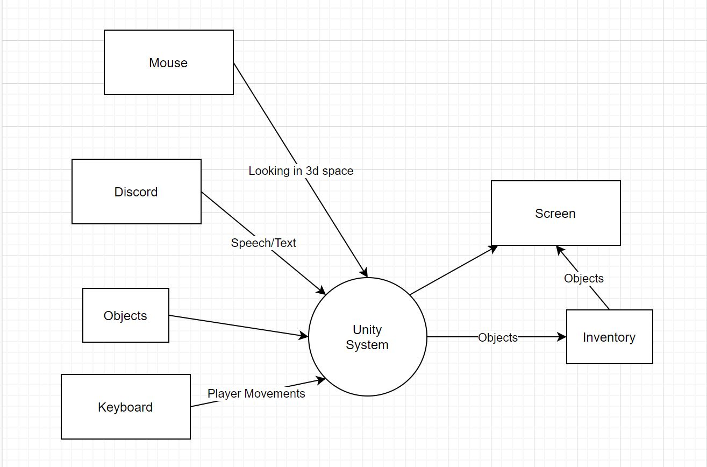
Section 2: High Level Design Author: Brandon London

Slide 5
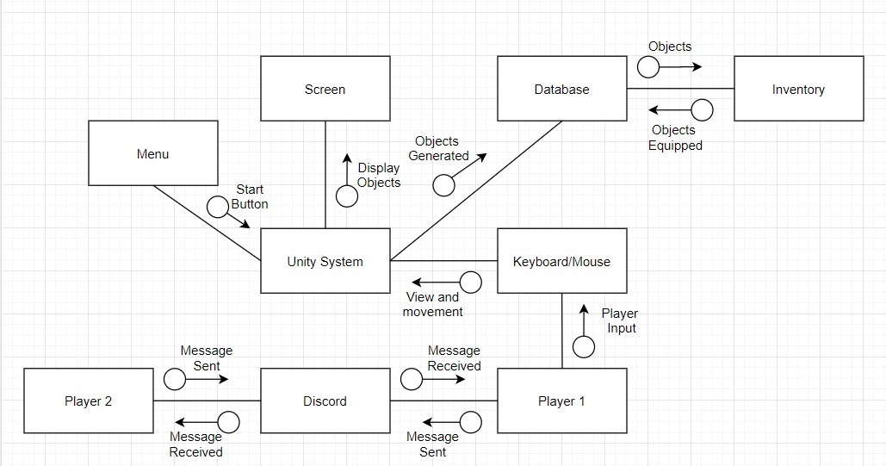
Section 3: More Detailed Design Author: Timothy Schultz

Slide 6
Section 4: Installation Instructions
Unity:
Go to Unity website: https://unity.com/.
Create an account.
Go to Unity store website: https://store.unity.com/?_ga=2.9598709.1359179693.1604289619-980513793.1602088229#plans-individual.
Under the “Individual” tab. In the section “Personal” click on the get started button.
Now the Unity Download Assistant will prompt the user to choose what Unity components to download. This should automatically have the latest version of Unity checked.
Program:
Get source code for program. (This could be a clone from GitHub or from secondary memory).
Open Assignment3.exe in Build folder and game will launch.

Slide 7
Appendix A. Implementation Code
Unity Store Assets/Scripts:
First Person Controller
First Person Movement, First Person Look, Crouch, Ground Check, Jump, and Zoom.
Virtual Playground
Dim Box.
Devion Games
Inventory Manager.
Quiz
Menu

Slide 8
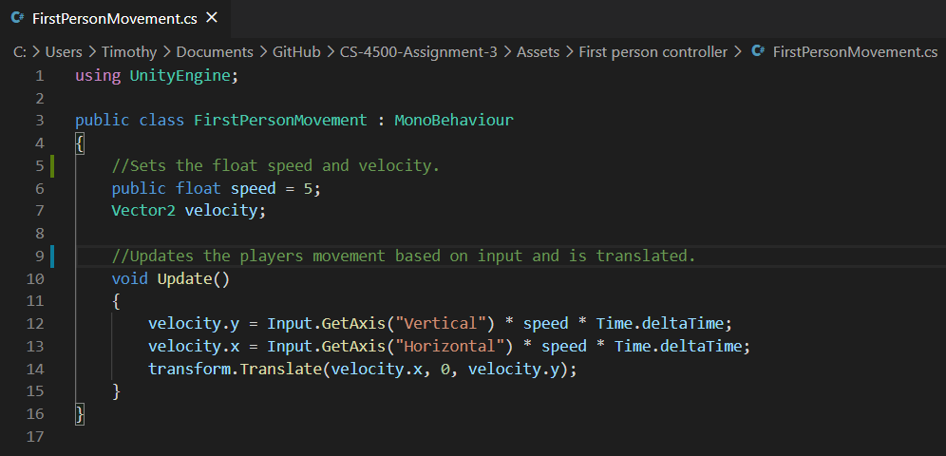
First Person Controller
First Person Movement

Slide 9
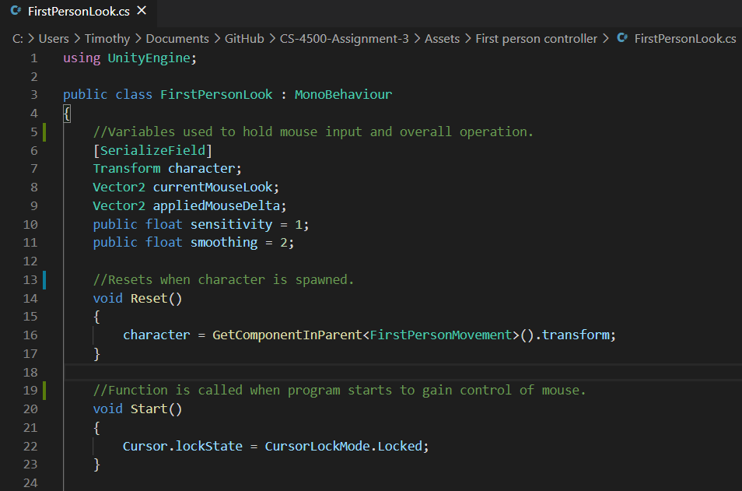
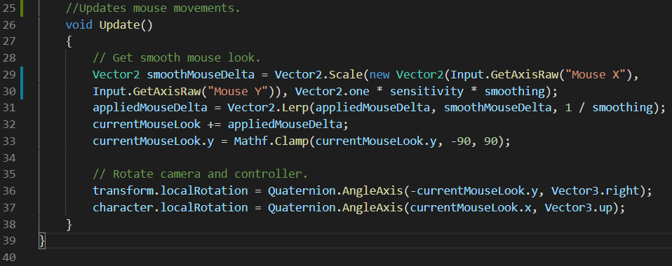
First Person Look

Slide 10
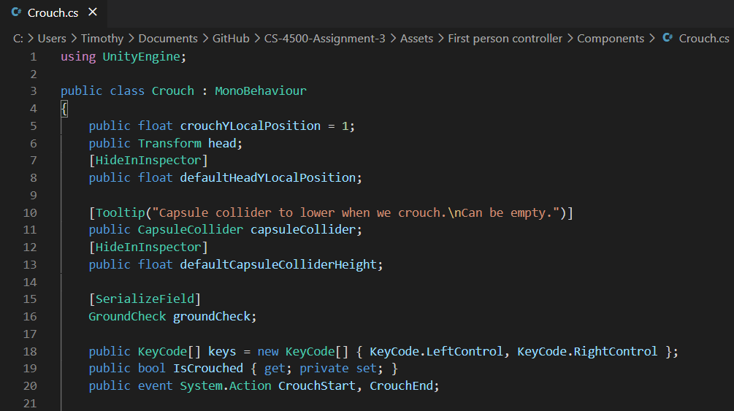
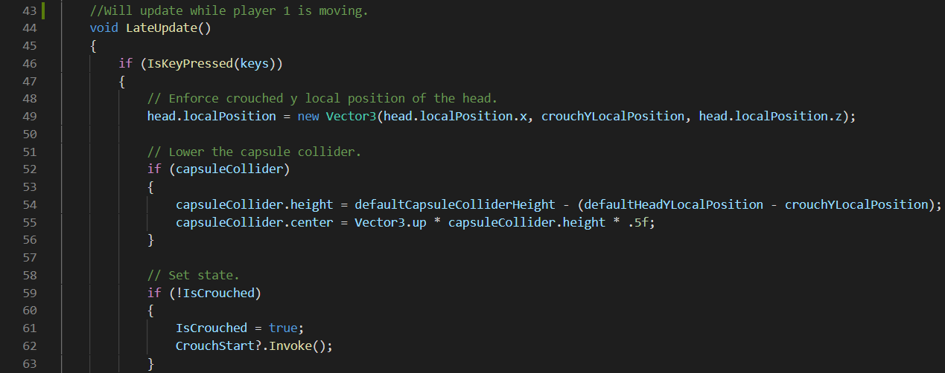
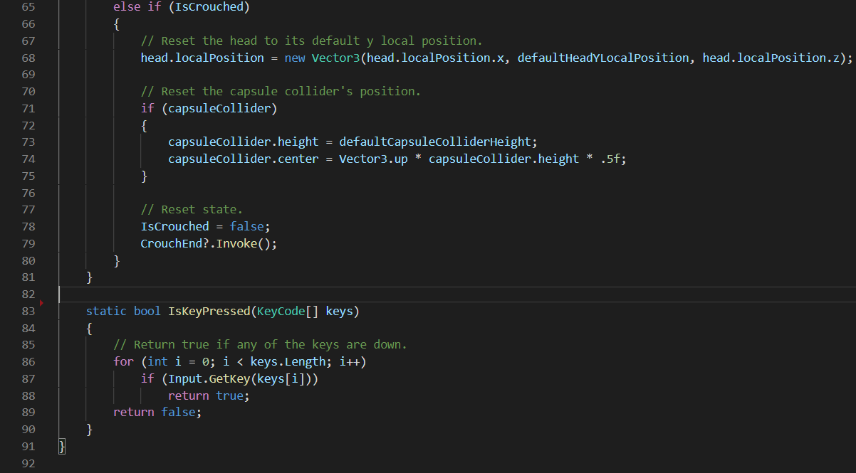
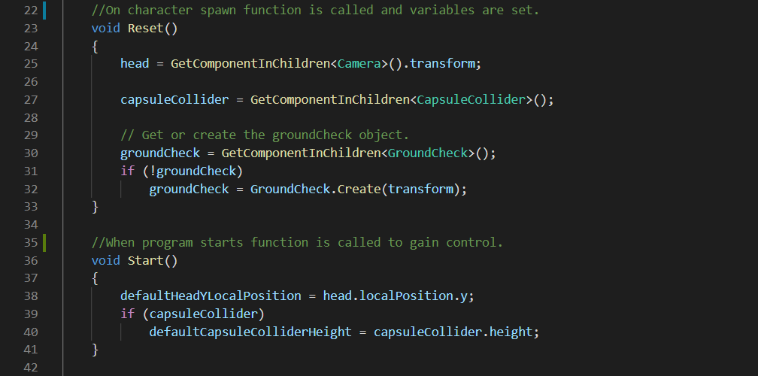
Crouch

Slide 11
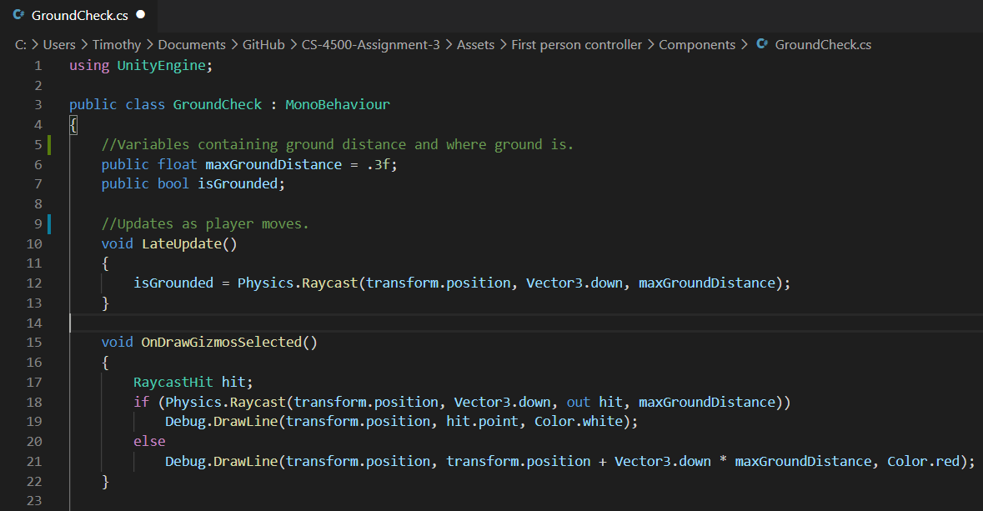
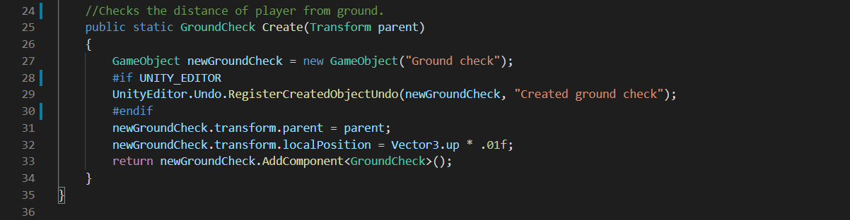
Ground Check

Slide 12
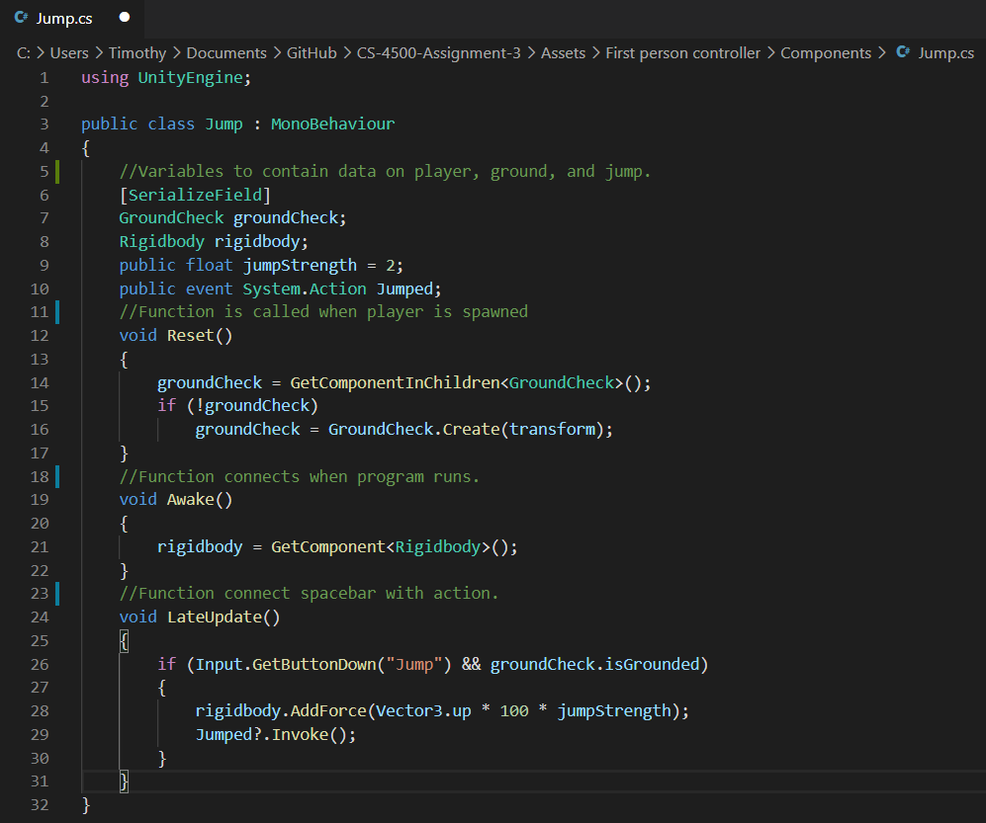
Jump

Slide 13
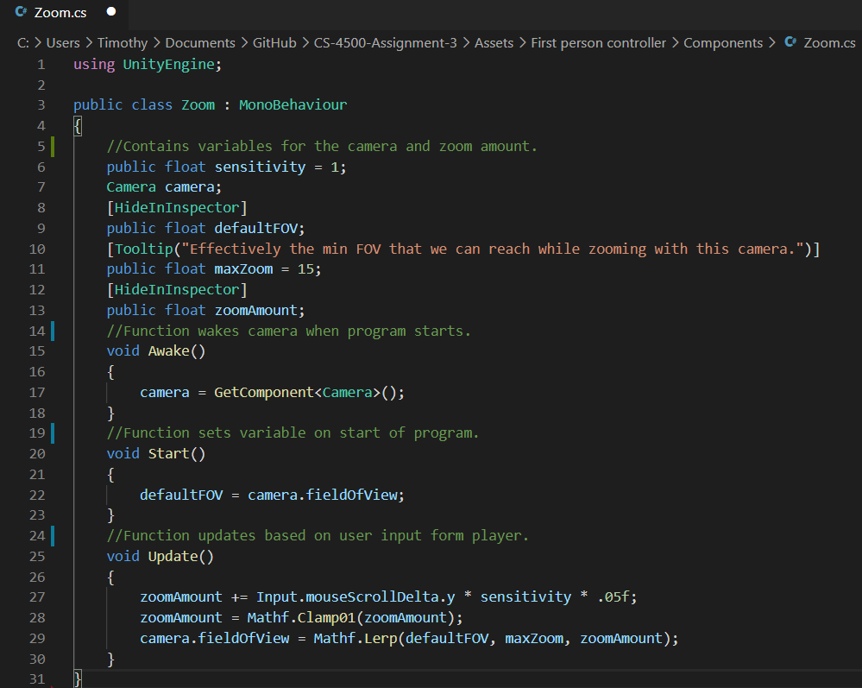
Zoom

Slide 14
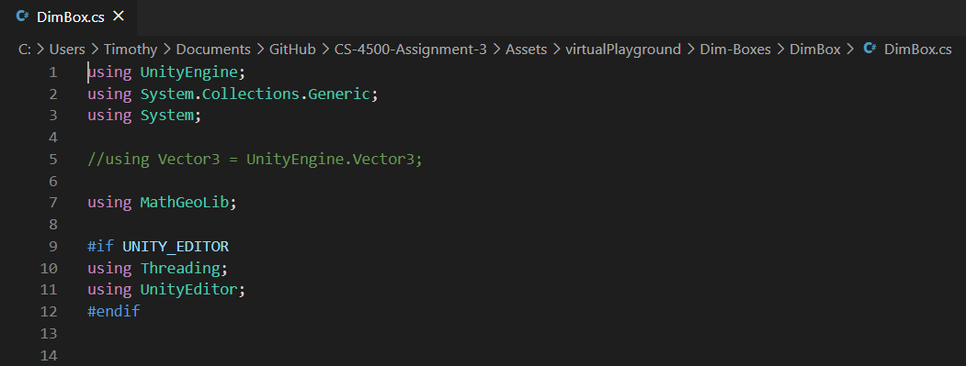
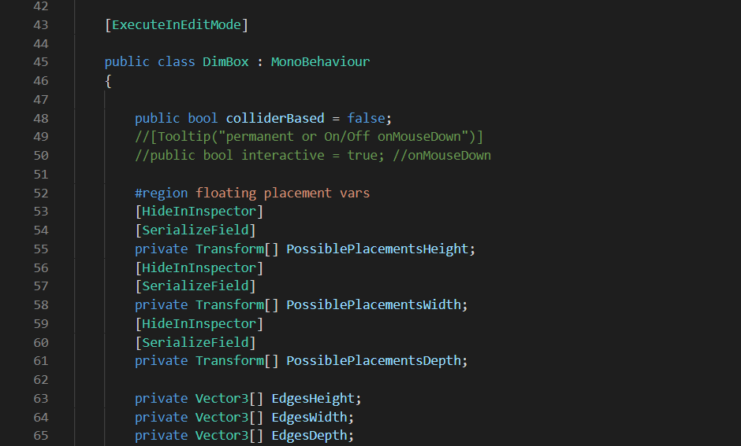
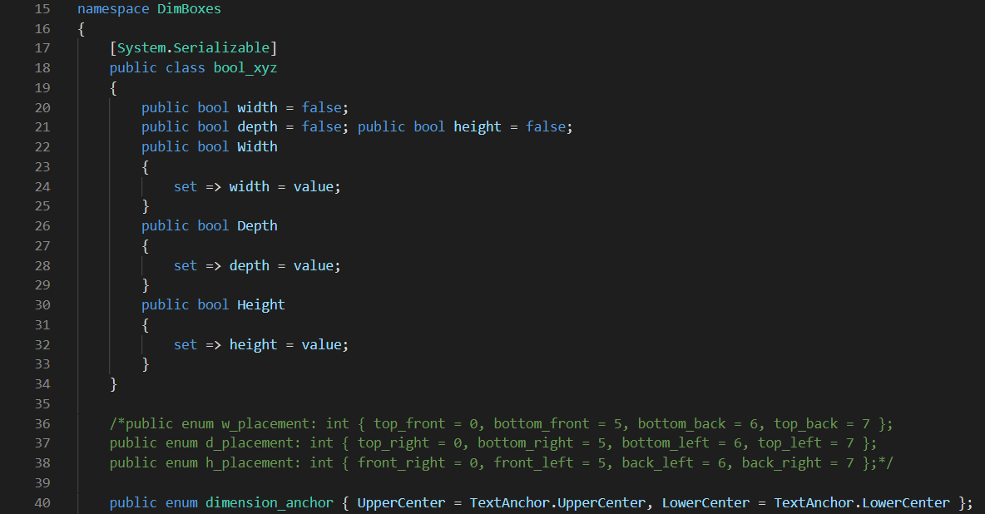
Virtual Playground
Dim Box

Slide 15
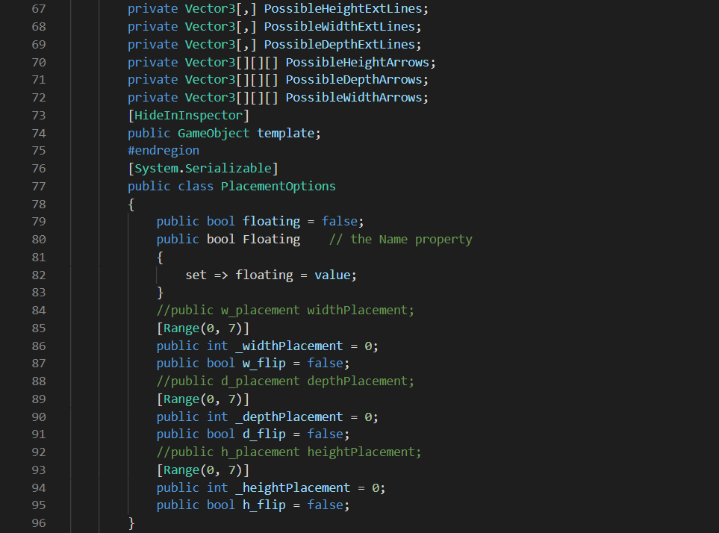
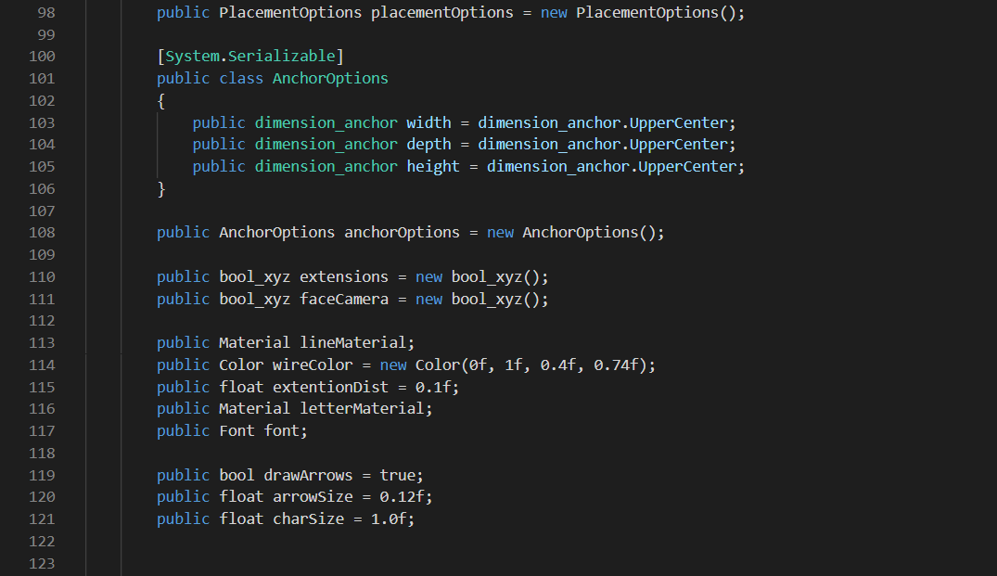

Slide 16
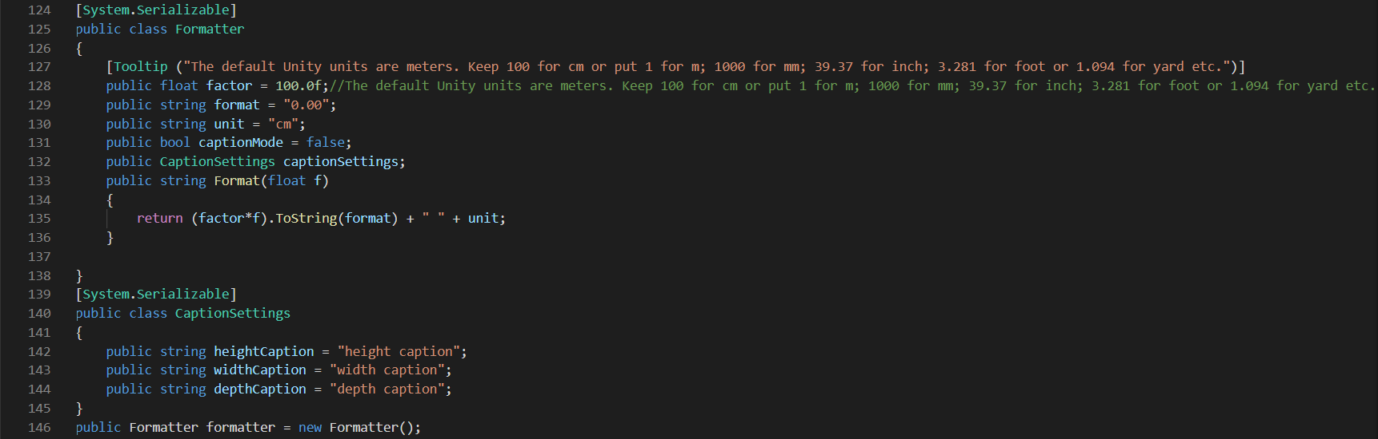
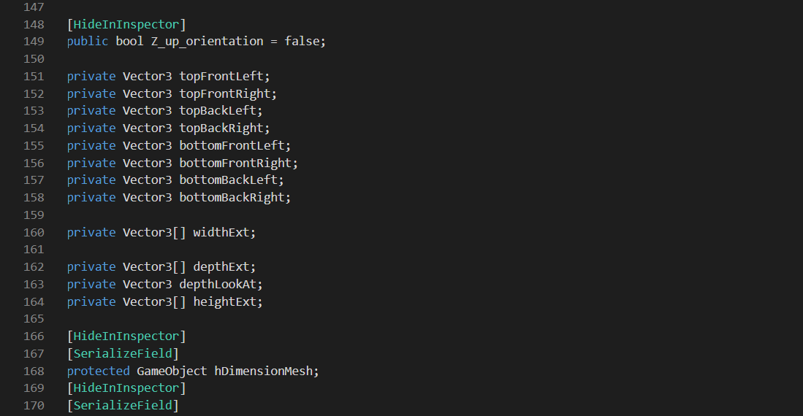

Slide 17
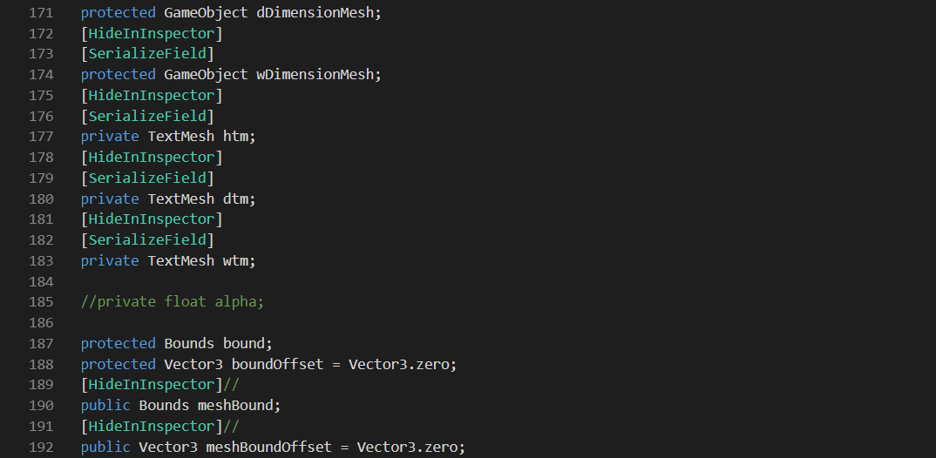
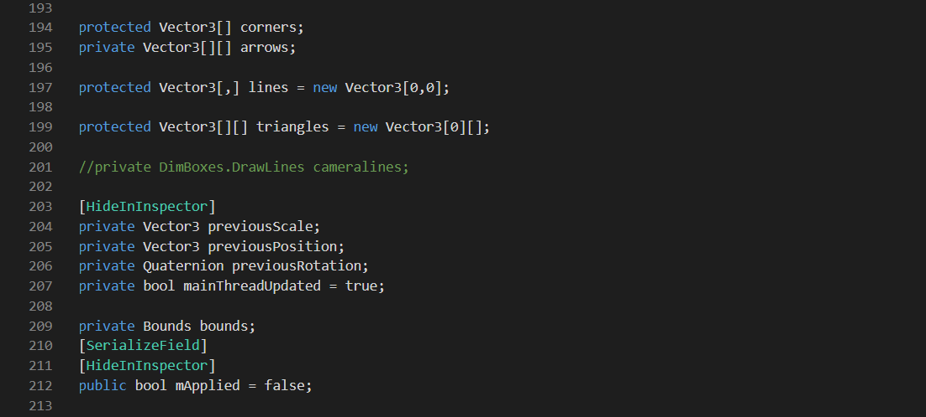

Slide 18
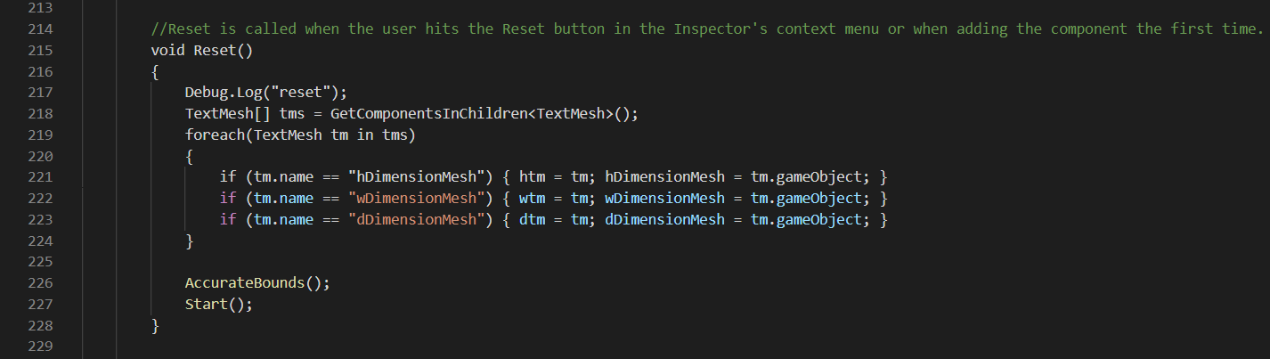
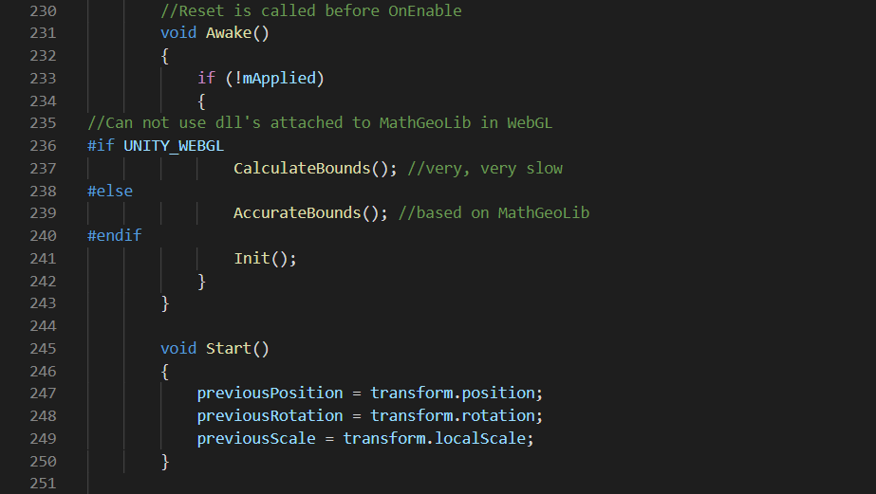

Slide 19
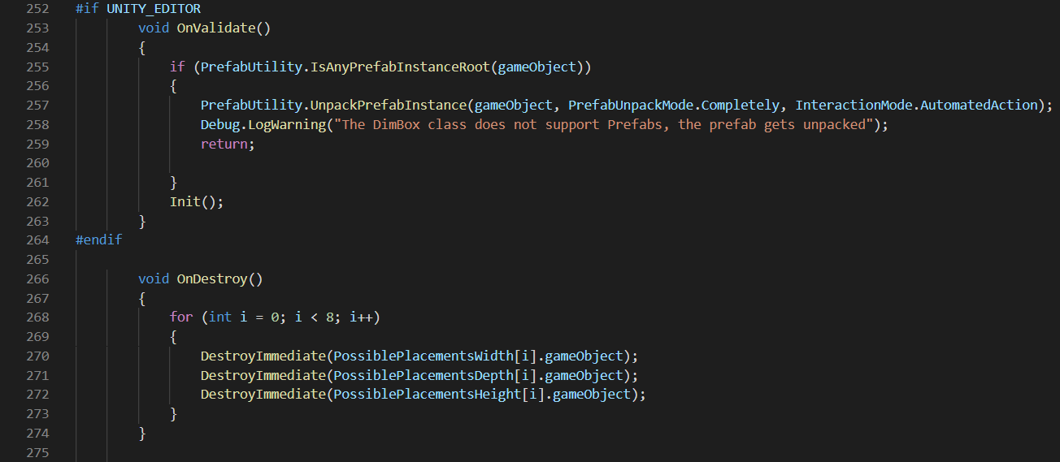
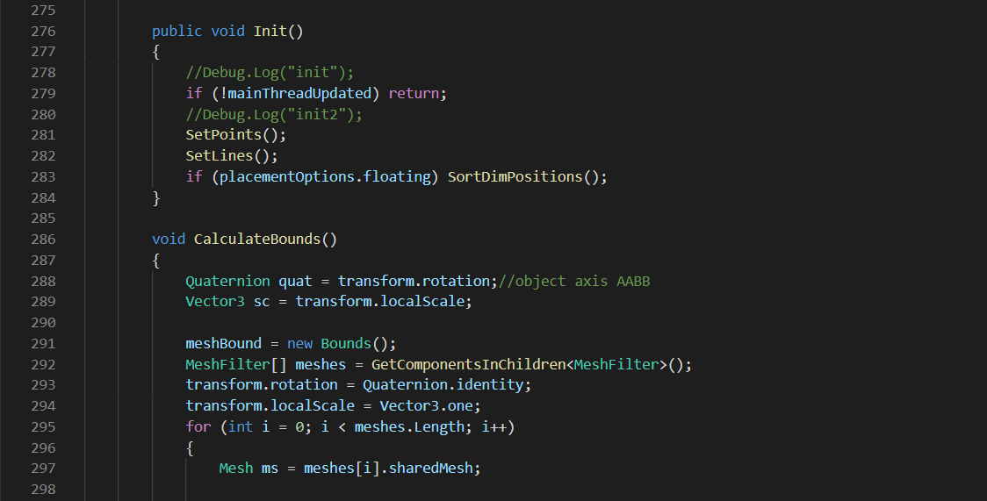

Slide 20
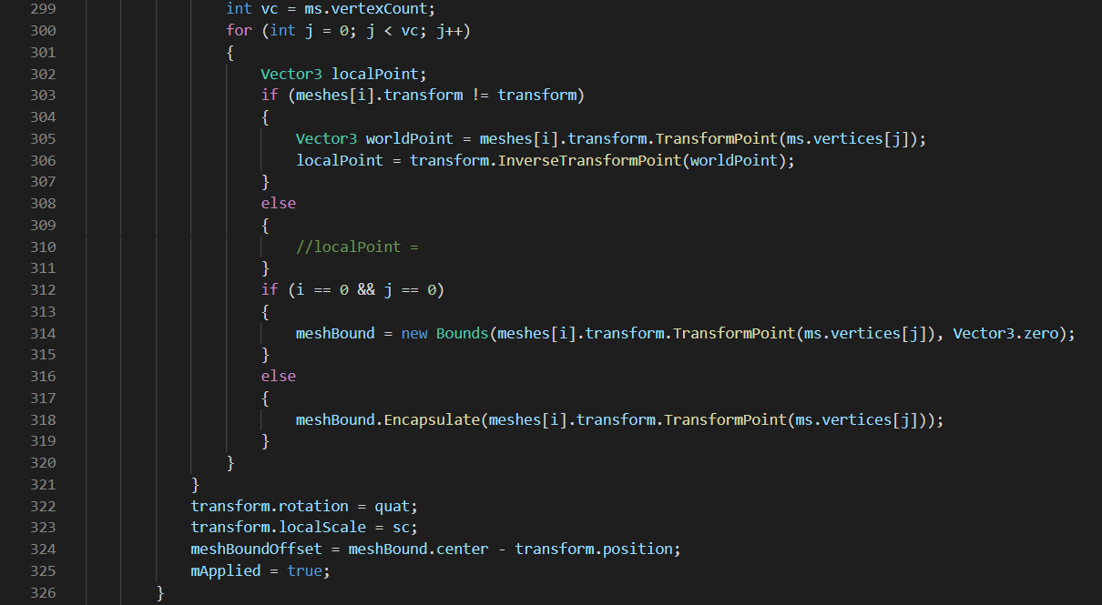
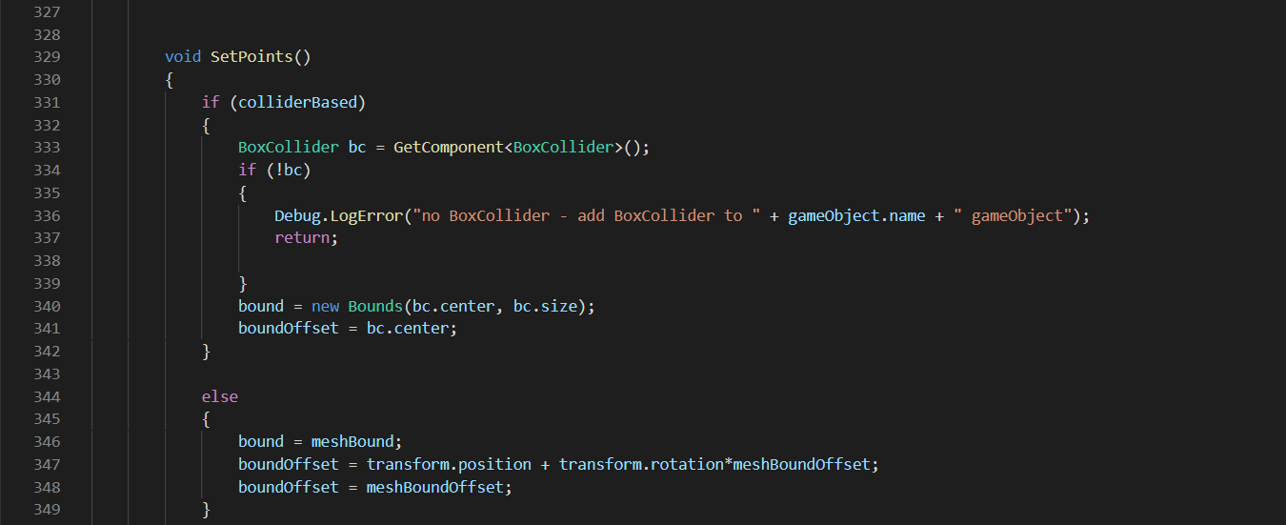

Slide 21
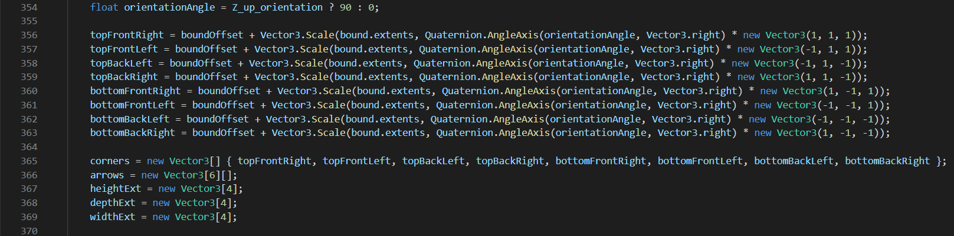
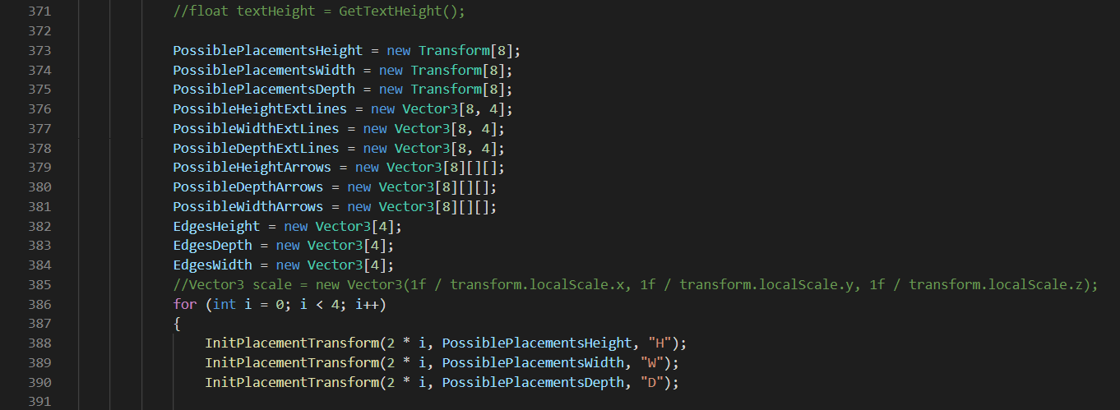

Slide 22
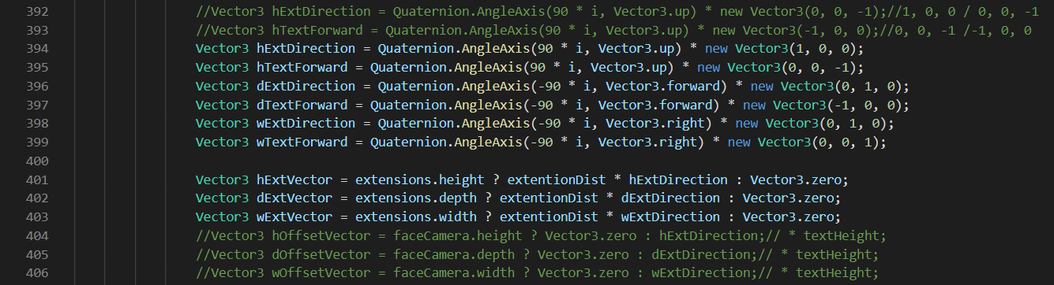
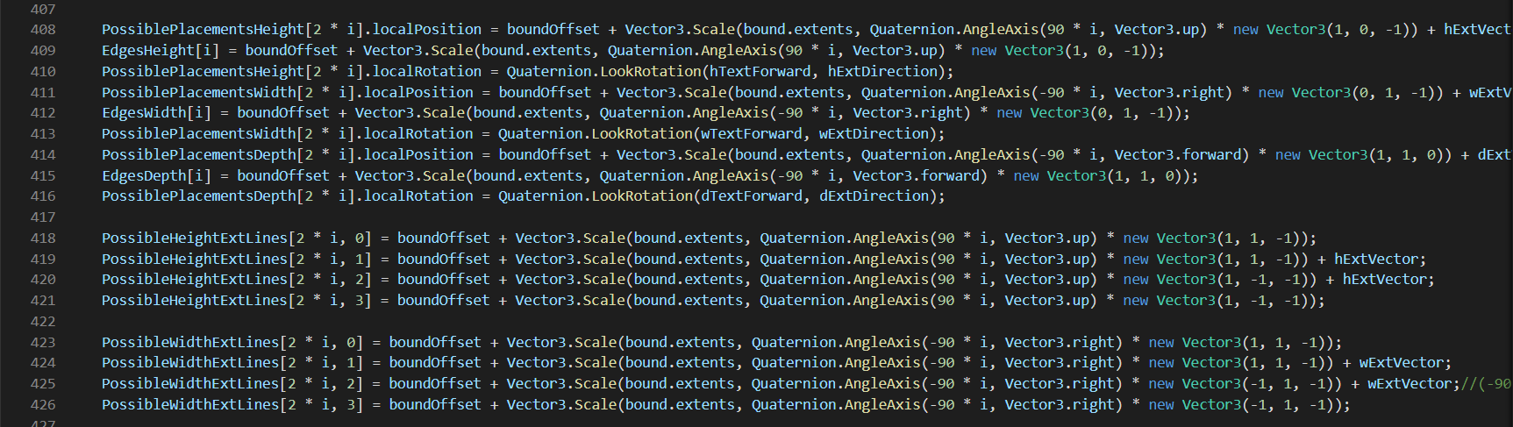

Slide 23
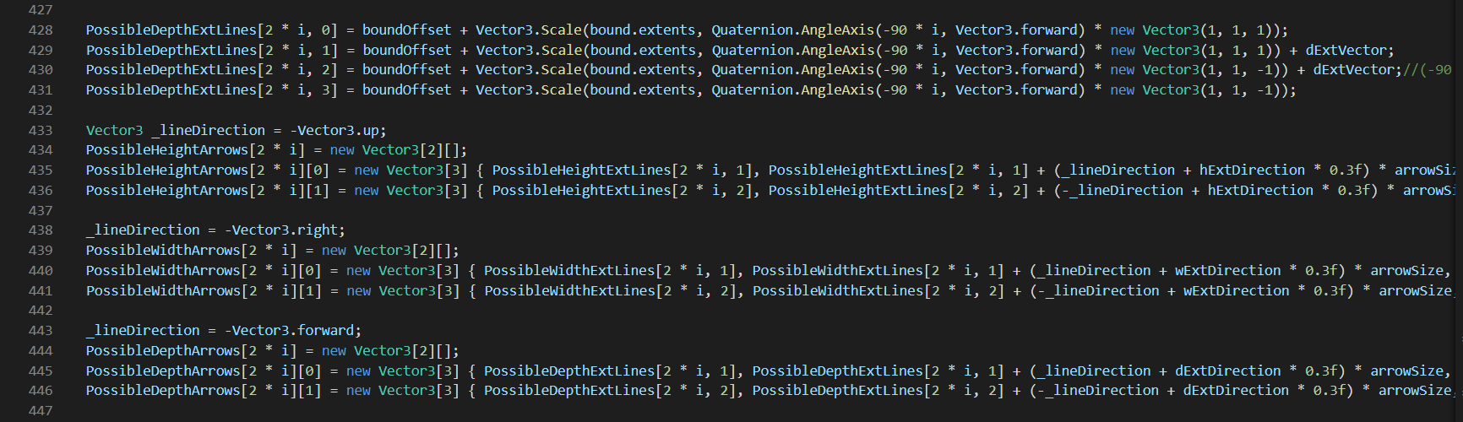
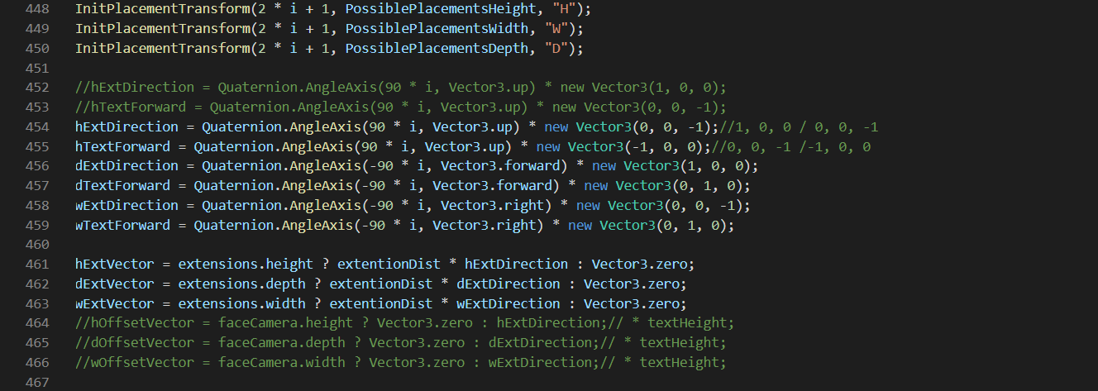

Slide 24
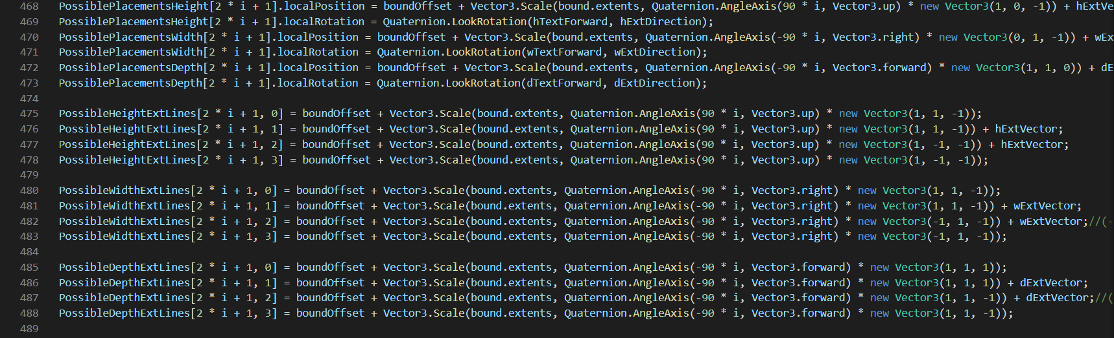
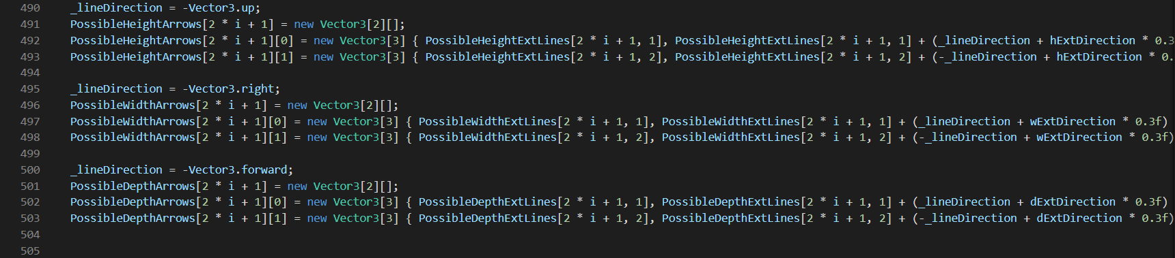

Slide 25
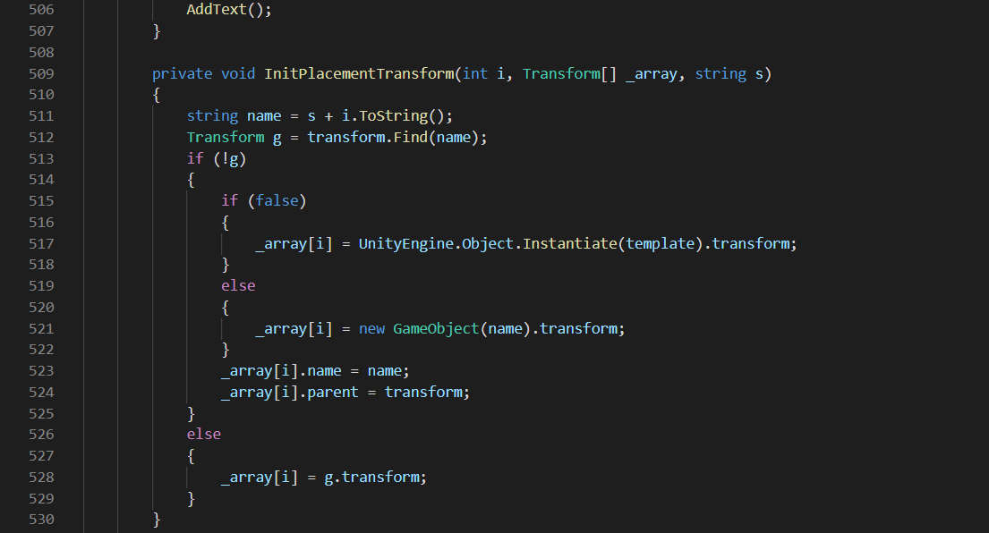
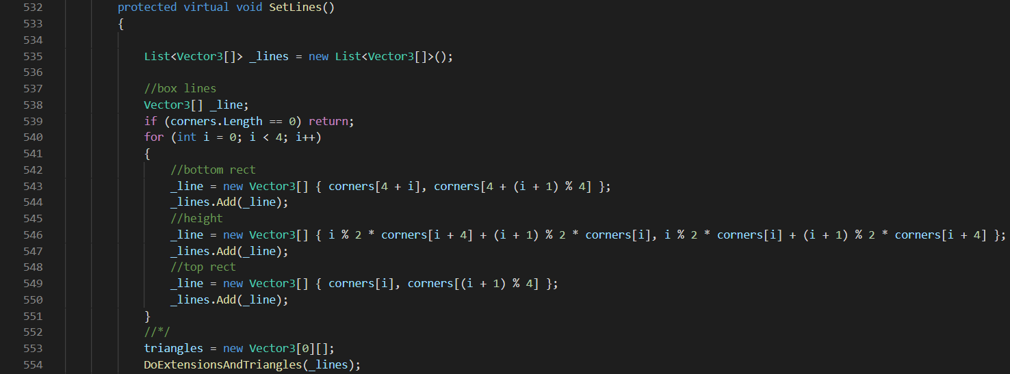

Slide 26
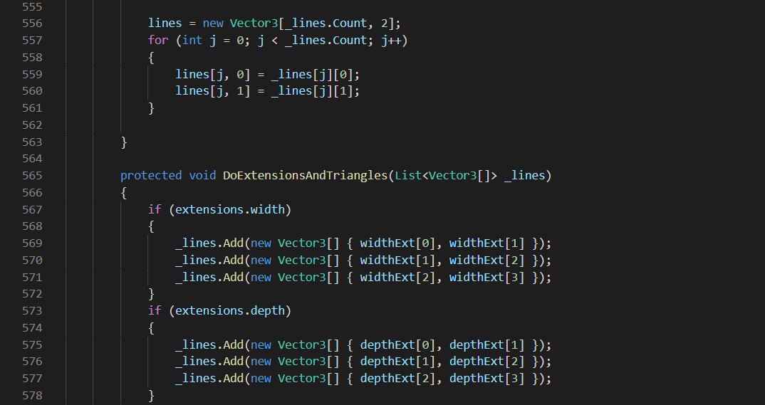
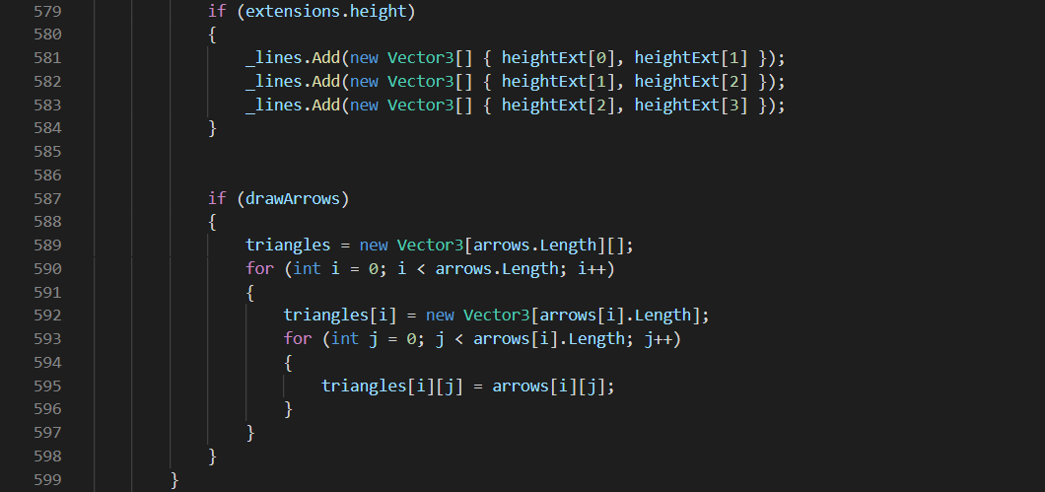

Slide 27
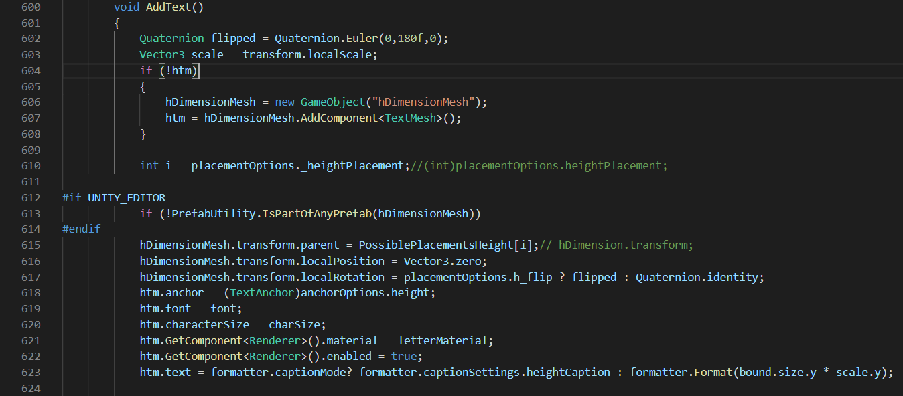
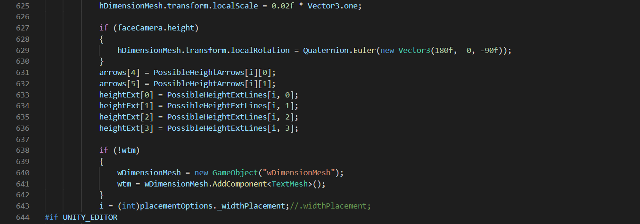

Slide 28
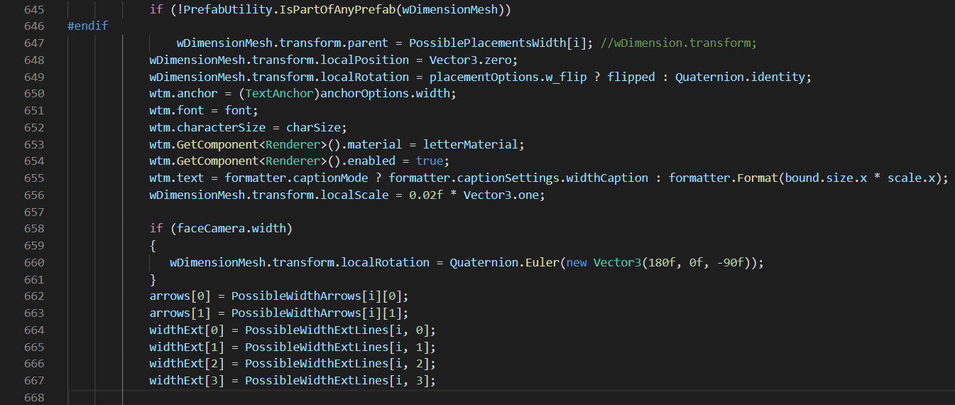
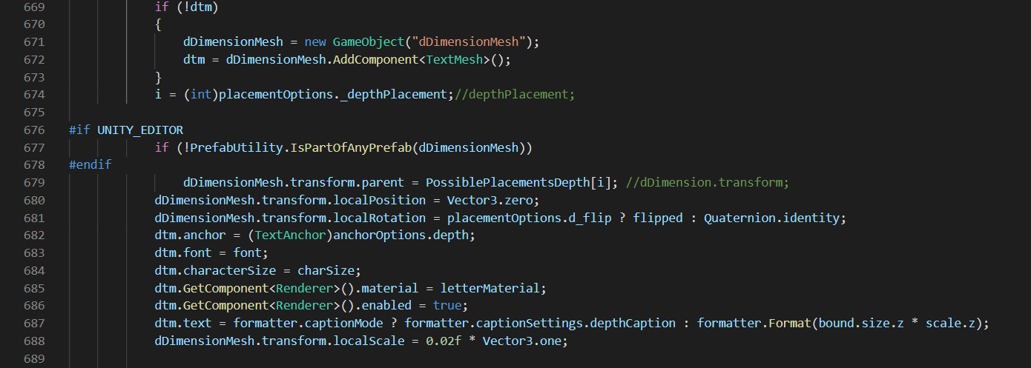

Slide 29
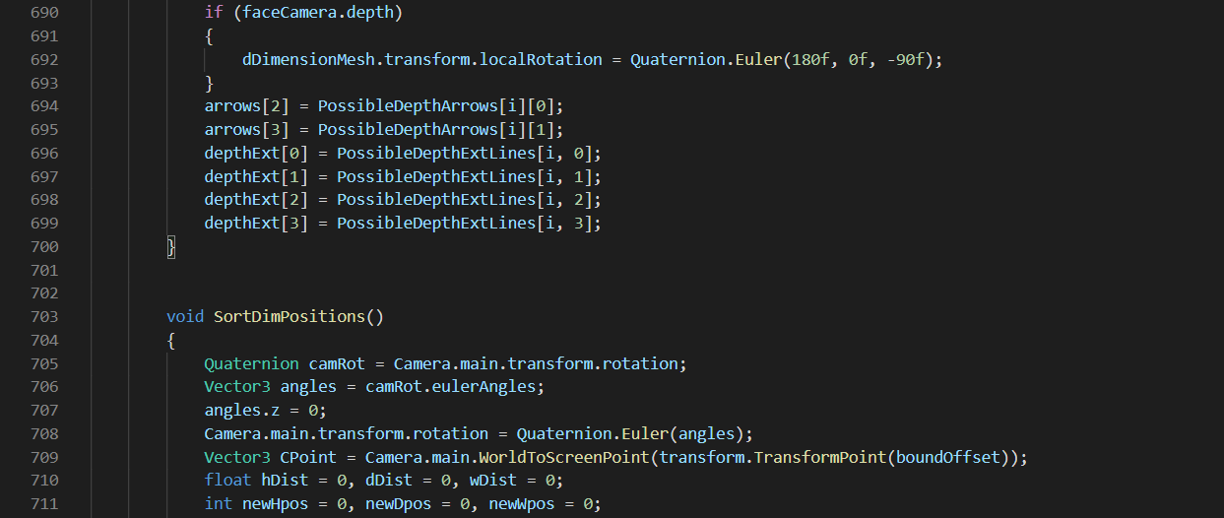
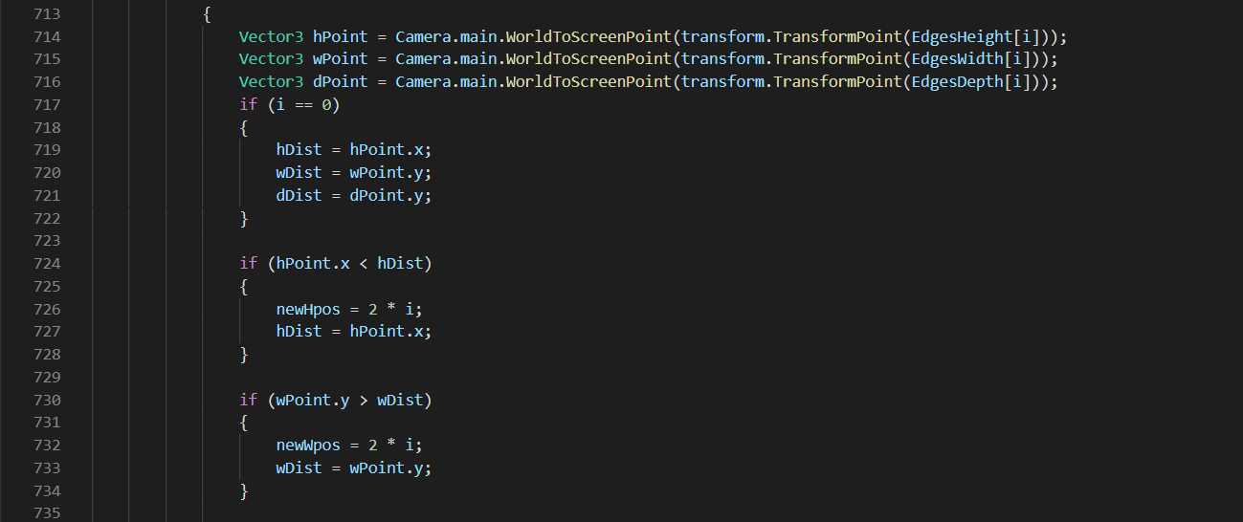

Slide 30
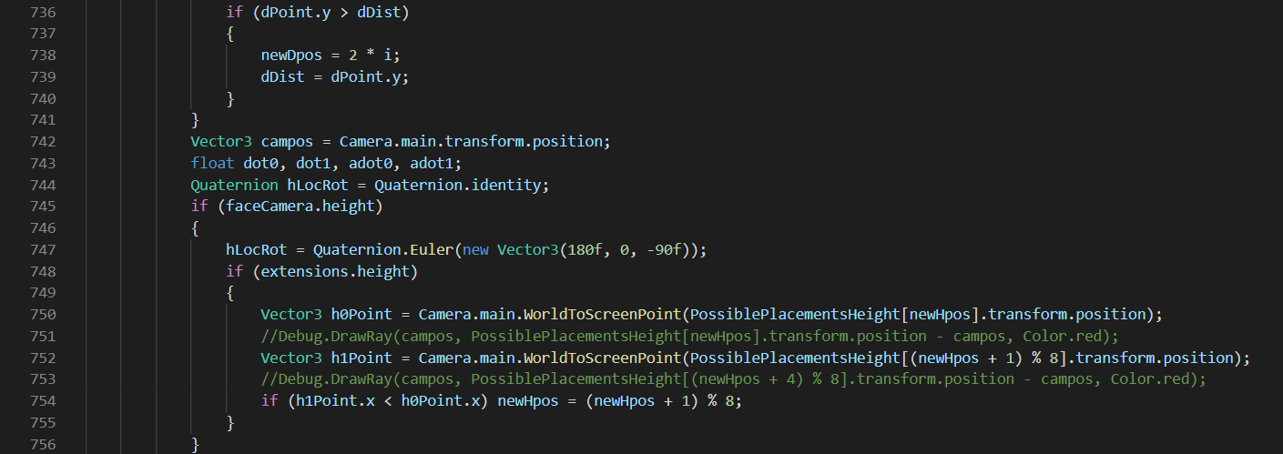
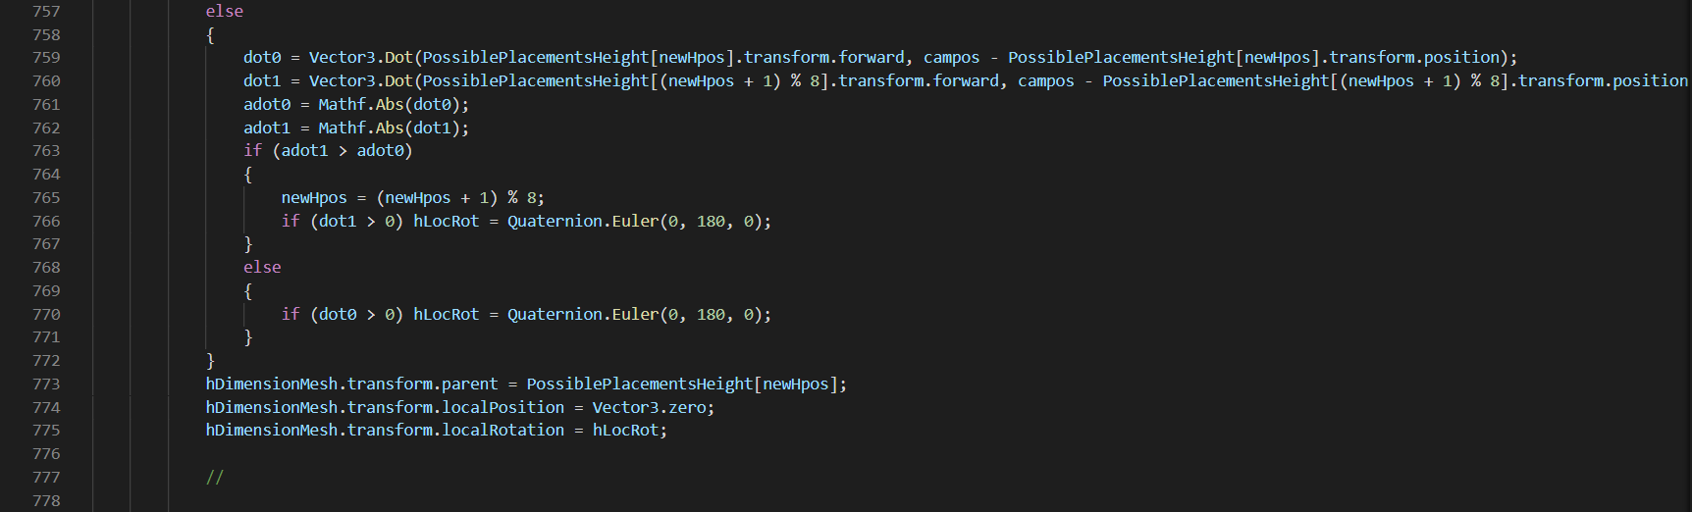

Slide 31
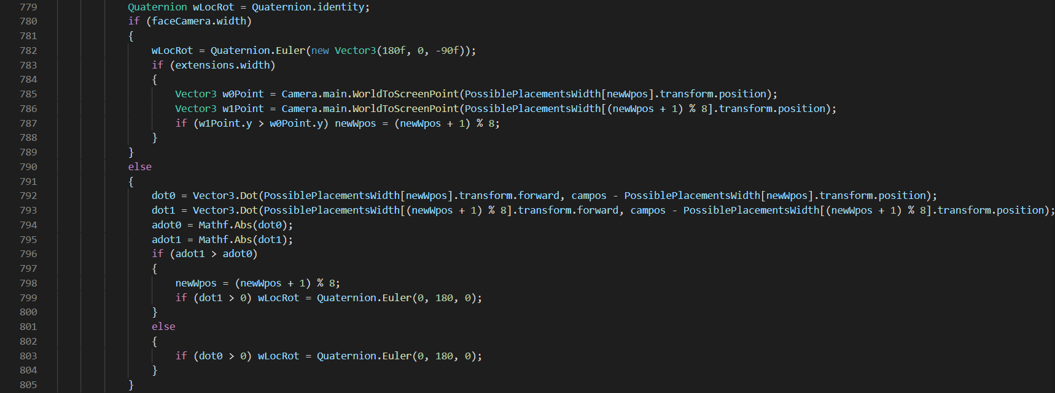
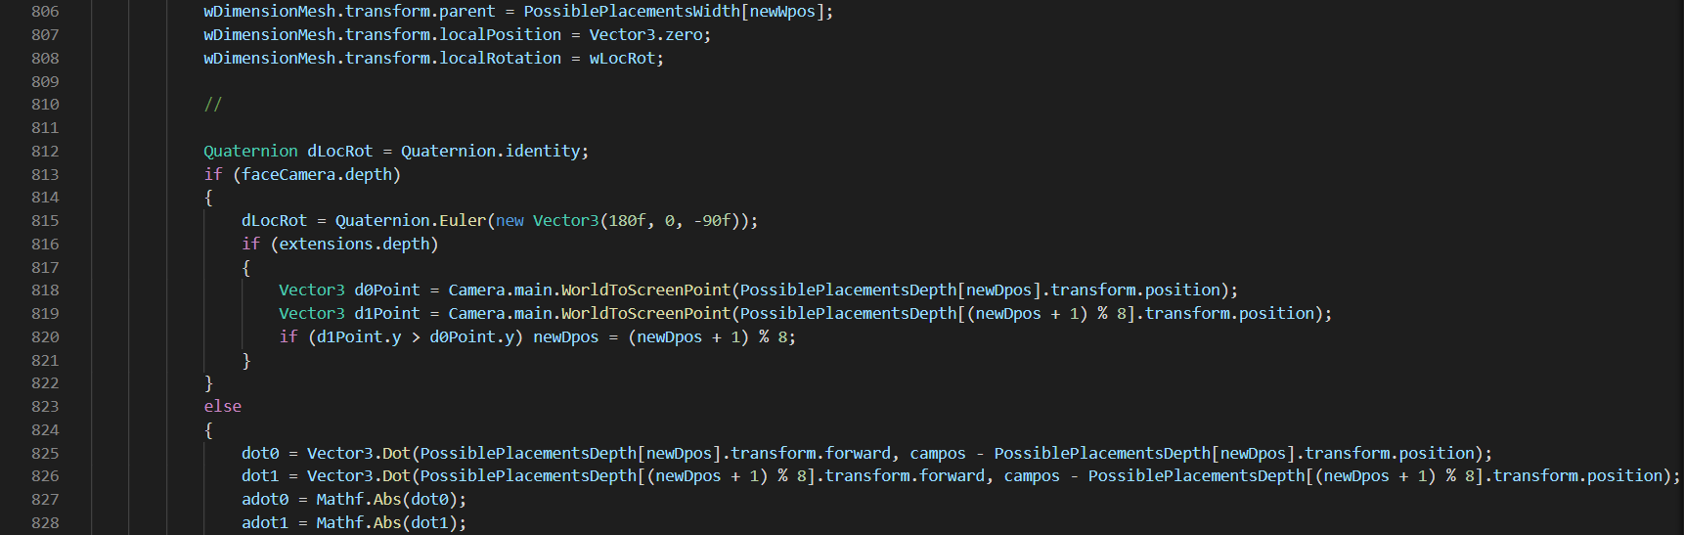

Slide 32



Slide 33



Slide 34



Slide 35



Slide 36



Slide 37



Slide 38



Slide 39



Slide 40

Devion Games
Inventory Manager

Slide 41



Slide 42



Slide 43



Slide 44



Slide 45



Slide 46



Slide 47



Slide 48



Slide 49


Slide 50

Quiz Script (UIScript07.cs)
Shows the right answers for the quiz

Slide 51


Slide 52


Slide 53


Slide 54

Quit Script
Quits the game

Slide 55

ChangeScene
Directs player to correct scene

Slide 56
Appendix B. User Manual Author: Jake Hasenfratz Updated: Timothy Schultz
Game Controls
Movement: Arrow keys or standard keys a, w, s, d.
Crouch: ctrl key
Zoom: Mouse scroll click magnification or touch pad magnification.
Jump: Spacebar.
Inventory: I key.
Camera movement: Mouse.

Slide 57
Starting the Game
When the program starts the two players will select either to be player one or player two. Player one will be taken to the Planet X scene. Player two will be taken to the Quiz scene.
The second Player will need to identify what Item Player One has found based on the dimension, mass, and volume.

Slide 58
Communication
There are a two different ways for the Players to communicate with each other.
If they are playing on grade school difficulty for the game, they will use Discord Voice communication.
If they are playing middle and high school difficulty, they will use Discord text channels to communicate.
Players will connect to the server using the player one and player two buttons on the menu.

Slide 59
Player One
Player One will spawn into the planet with an inventory containing a scale and tape measure.
As they walk around the planet, they will find 3 items.
If high school difficulty is picked the Player may find more than 3 objects because some of the objects may have a broken part that got scattered that will need to be added into their dimension, mass, and volume when Player Two tries to figure out what item they found.

Slide 60
Player Two
Player Two will have a quiz displayed.
Question 1: What is the item?
Question 2: What is the force/weight of the item?
Question 3: What is the density of the item?
As Player One communicates what item they found in the game using only the dimensions, mass, and volume, Player Two will have to guess what item it is based on the list of items they see on the screen.

Slide 61
Middle School
You will have to use Discord Text channels to communicate when playing Middle School difficulty of the game.
You will have 3 items within the game world to find and for Player Two to identify.
Player Two will have fill out the quiz as Player One finds each object.
Using the dimensions, mass, and volume Player Two will have to guess which object Player One has found.

Slide 62
Future Implementation User Guide
Grade School
You will use Discord Voice communication.
There will be 3 Game Objects that Player One will need to find within the game world.
Player Two will have a cheat sheet of the four items in the world.
Player One can tell Player Two the dimensions of each object and they will have to guess what object it is.
High School
You will have to use Discord Text channels for communication.
There will be 3 items that Player One needs to find, some of the items may be broken. You will need to find the force/weight and density of all pieces.
Player Two will fill in the quiz as Player One finds them.
Player Two must identify each of the 3 objects using their dimensions, mass, and volume.

Slide 63
Appendix C. Test Plan Author: Robbie Wadud Updated: Timothy Schultz
Tester Contact Information
Revision History
 | Robbie Wadud | Timothy Schultz
Email | aswnc6@umsystem.edu | tjsb8d@umsystem.edu
Phone Number | 573-529-2822 | 636-497-2749
Date of Change | Change | Result
11/10/2020 | Started Documentation | Success on all Tests
11/16/2020 | Test 2.6 Added | 2.6 Failed
12/07/2020 | Retest | Success on all Tests
12/11/2020 | Added Tests for Menu and Quiz. | Success on all Tests

Slide 64
Introduction
Planet X is a 3D co-op game that requires two participants. The first player is an astronaut exploring a mysterious planet collecting peculiar items. The astronaut can measure the dimensions, weight, volume of each object but doesn’t exactly know what the items are. The second player is a researcher determining what the first has found. The two are communicating between each other to discover and label all objects found to answer the questions on the quiz.
There are three levels of difficulty to choose from. Grade school difficulty is the easiest level. This is because players can communicate via Discord voice chat. Middle School difficulty adds some difficulty to the game. Participants can only communicate with Discord text chat. High school, the most difficult rendition of the game, also requires players to communicate only with Discord text chat. The players also must identify broken objects.

Slide 65
Items to be Tested
2.1: Jumping Mechanic
This test is to find if the jumping mechanics work for the first player. In other words, check to see if the Jump script works.
We plan to test this by pressing space bar when the game loads. If the character jumps, then we know the test has succeeded.
Testing Info:
11/10/2020 by Robbie Wadud (Success)
11/16/2020 by Timothy Schultz (Success)
12/7/2020 by Robbie Wadud (Success)
12/7/2020 by Timothy Schultz (Success)

Slide 66
2.2: Left, Right, Forward, and Backward Mechanics
This test is to find if the left, right, forward, and backward mechanics work for the first player. In other words, check to see if the FirstPersonMovement script works.
We plan to test this by pressing W (forward), A (left), S (backward), and D (right) when the game loads. If the character moves in the respective directions, then we know the test has succeeded.
Testing Info:
11/10/2020 by Robbie Wadud (Success)
11/16/2020 by Timothy Schultz (Success)
12/7/2020 by Robbie Wadud (Success)
12/7/2020 by Timothy Schultz (Success)

Slide 67
2.3: Camera Movement
This is a test to see if player one can move the camera. In other words, check to see if the FirstPersonLook script works.
We plan to test this by moving the mouse around when the game loads. If the character has different viewpoints (as if they were turning), then we know the test has succeeded.
Testing Info:
11/10/2020 by Robbie Wadud (Success)
11/16/2020 by Timothy Schultz (Success)
12/7/2020 by Robbie Wadud (Success)
12/7/2020 by Timothy Schultz (Success)

Slide 68
2.4: Zoom Mechanic
This is a test to see if player one can zoom in and out. In other words, check to see if the Zoom script works.
We plan to test this by scrolling with the mouse when the game loads. If the game zooms in, then we know the test has succeeded.
Testing Info:
11/10/2020 by Robbie Wadud (Success)
11/16/2020 by Timothy Schultz (Success)
12/7/2020 by Robbie Wadud (Success)
12/7/2020 by Timothy Schultz (Success)

Slide 69
2.5: Inventory Mechanic
This is a test to see if player one can access their inventory.
We plan to test this by pressing “i” when the game loads. If the inventory appears, then we know the test has succeeded.
Testing Info:
11/10/2020 by Robbie Wadud (Success)
11/16/2020 by Timothy Schultz (Success)
12/7/2020 by Robbie Wadud (Success)
12/7/2020 by Timothy Schultz (Success)

Slide 70
2.6: Crouch Mechanic
This is a test to see if a player can crouch.
We plan to test this by pressing “ctrl” when the game loads. If the player is crouching, then we know the test has succeeded.
Testing Info:
11/10/2020 by Robbie Wadud (Failed)
11/16/2020 by Timothy Schultz (Failed)
12/7/2020 by Robbie Wadud (Success)
12/7/2020 by Timothy Schultz (Success)

Slide 71
2.7: Player One, Player Two, and Quit Menu Buttons
Player One button was tested to verify player one is spawned in the Planet X Scene. Player Two button was tested to verify player two was taken to quiz scene. Quit button was tested to verify program terminates.
Testing Info:
12/11/2020 by Robbie Wadud (Success)
12/11/2020 by Timothy Schultz (Success)

Slide 72

2.8: Quiz multiple choice questions, fill-in blank questions, and Submit button.
Verified that multiple choice and fill-in the blank questions worked. Submit button was tested to verify that answers were entered, and correct answers are displayed.
Testing Info:
12/11/2020 by Robbie Wadud (Success)
12/11/2020 by Timothy Schultz (Success)

